Slide 1


2. Entering Employee Data
HRMS Training

Slide 2
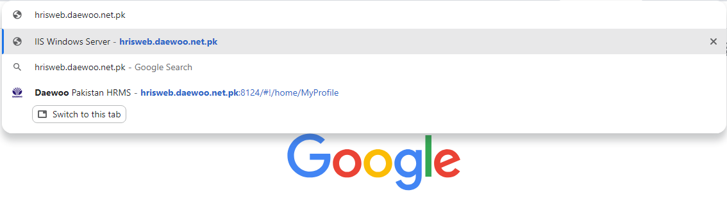
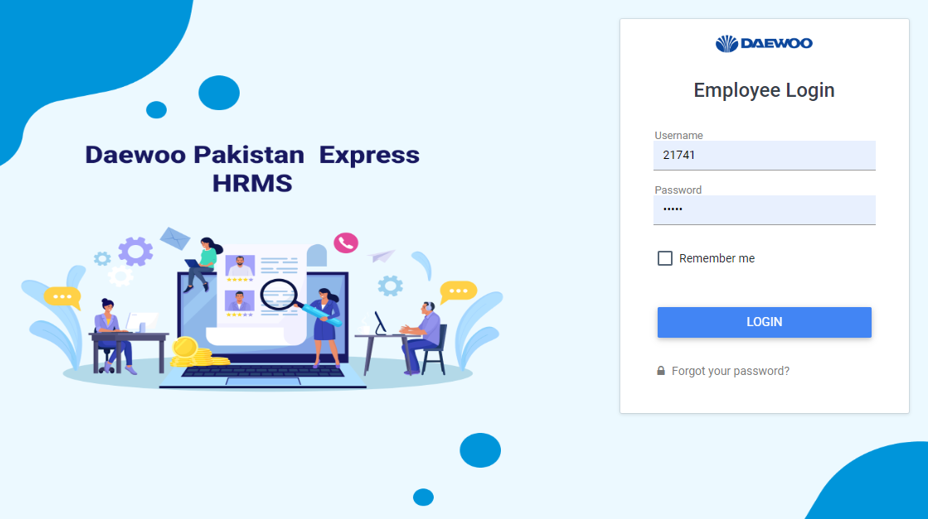
STEP 1
Open Google Chrome. Enter the URL
hris.web.daewoo.net.pk
STEP 2
Enter your Login Details
(Employee username &Password) to login to your profile

Slide 3
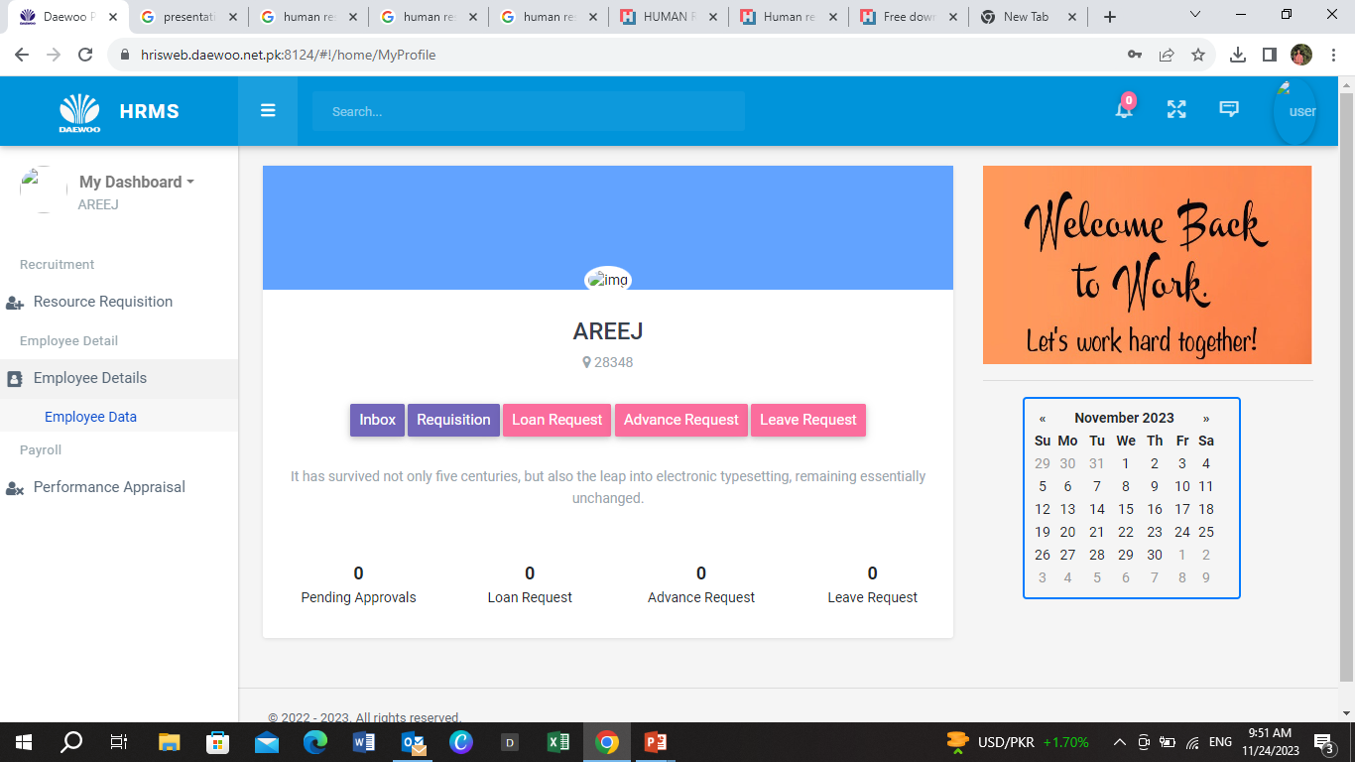
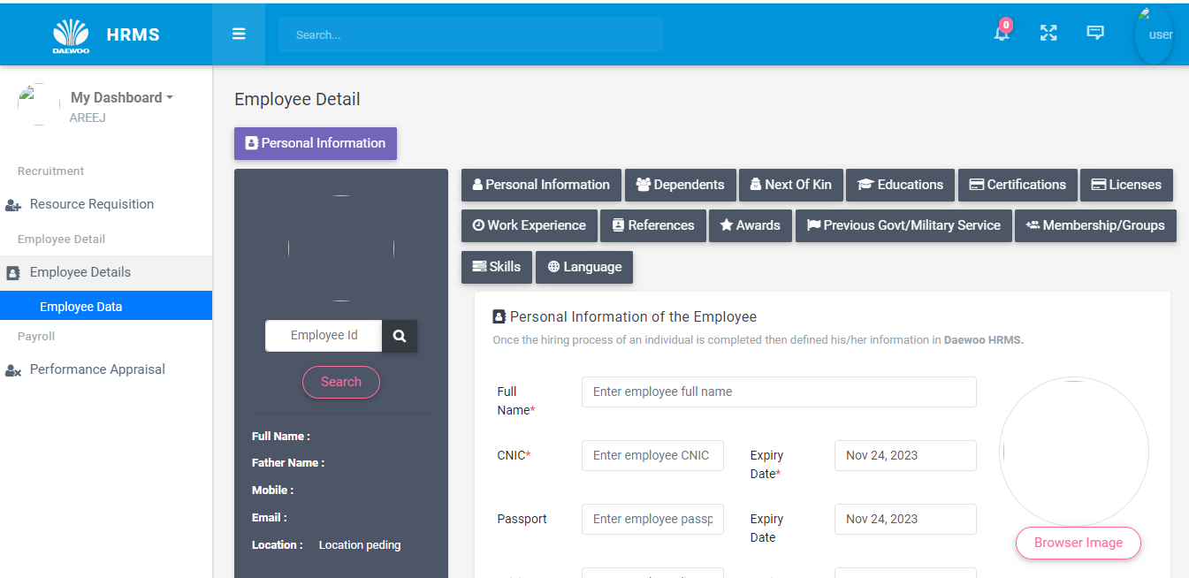
The * symbol indicates that the section must be completed.
Homepage will appear
STEP 3
On Left side of homepage, click Employee details, then Employee data
STEP 5
STEP 4
Click Personal Information
Enter Employee ID
STEP 6
Fill each section i.e. personal information, dependents, Next to kin etc. carefully.
STEP 7
Click Browse Image to add image to your profile
This page will appear

Slide 4
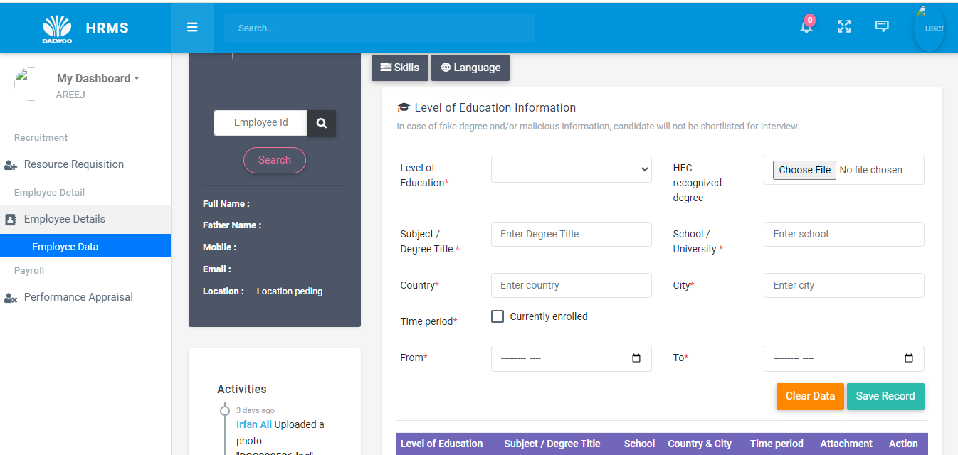
STEP 8
In case of any mistakes you can clear data and fill form again.
In case you have completed the file click Save Record and proceed

Slide 5
3. Office Information
HRMS Training

Slide 6
STEP 1
Open Google Chrome. Enter the URL
hris.web.daewoo.net.pk
STEP 2
Enter your Login Details
(Employee username &Password) to login to your profile

Slide 7
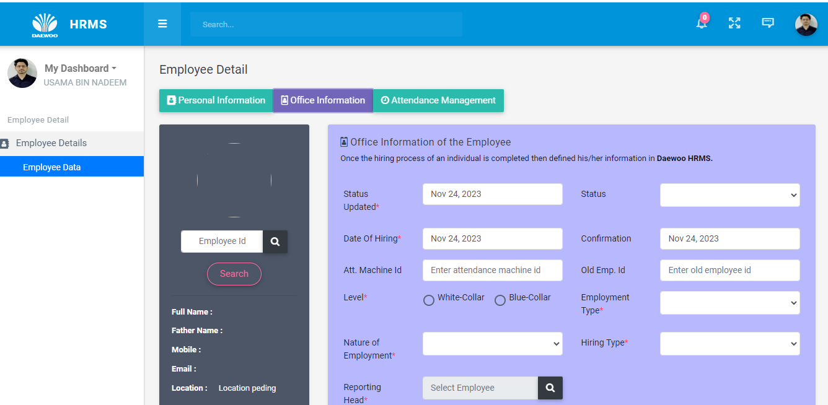
Homepage will appear
STEP 3
On Left side of homepage, click Employee details, then Employee data
STEP 5
STEP 4
Click Office Information
Enter Employee ID
STEP 6
Fill each section i.e. Status updated, Department, Sections etc. carefully.
This page will appear

Slide 8
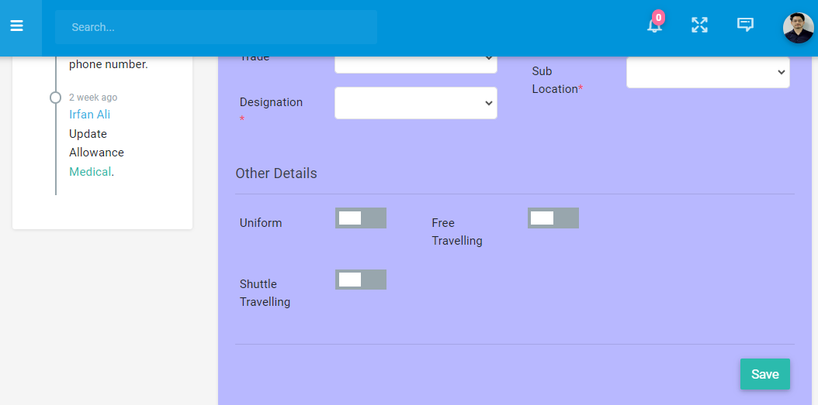
STEP 7
After Entering all required information click SAVE and proceed

